Slide 1
Recommender Systems
Jonathan Louie

Slide 2
Table of Contents
Introduction
Prevalence in society
Types of recommender systems
Evaluation
Demo

Slide 3
Introduction
What is a recommender system?
A combination of software tools and techniques used to suggest items of use to a user
Examples:
Items to buy
Videos to watch
Information feeds to follow

Slide 4
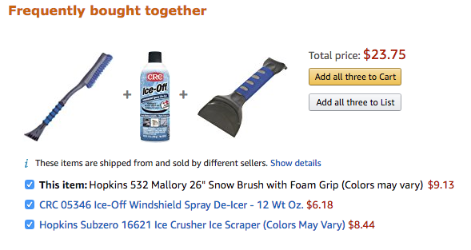
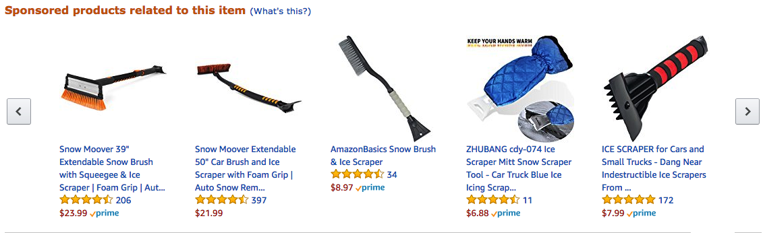

Slide 5
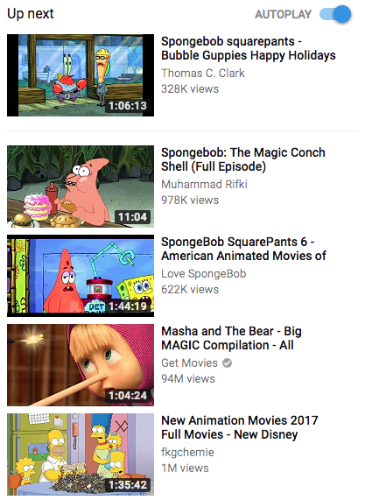

Slide 6
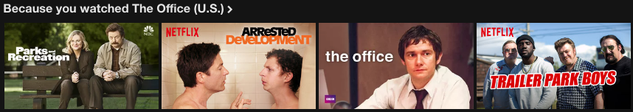

Slide 7
Why have they become so popular?
Business benefits
Increase conversion rate => Increase sales
Sell more diverse items
Better understand the user
Customer loyalty
Customer benefits
Find good items
Find a bundle of good items
Browse new, interesting items
Personalization through repeated user input over time
Express self, help or influences others
Notes:
Conversion rate = (# of users who buy vs users who just browse)
Bundle = items that go well together
Loaylty: (personalization => better suggestions => customer feels valued)
Personalization: (e.g. Pandora)
Express self, etc: Recommender systems require user data to function effectively, sometimes people are willing to give this information freely via review/ratings system

Slide 8
Bottom line:
High impact on sales, user engagement, and user experience
Loyalty
Trust
Brand development
Useful, Important
Notes:
Powerful tools that better customer-business relationship through all of the above

Slide 9
The Netflix Prize
Public competition to create a recommender system better than Netflix’s current system
Spanned 3 years, from 2006 to 2009
Over 100,000,000 data points
5,000 participating teams
$1,000,000 prize
Notes:
-First competition for recommender systems of this scale
-Highly competitive, but equally collaborative. Some of the top teams merged to form a single team or project, not just to win, but to push the boundaries of recommender system technology. Many participants were already a part of a research firm or founded their own research firms after the competition ended.
-Overall, very significant event in the history recommender systems in terms of exposure

Slide 10

Types of Recommender Systems
Association rules filtering
Recommends items by relating single items with bundles of items
Uses conditional probabilities and statistics based on previous user data
Example:

Slide 11
Content-based filtering
Find products with similar attributes
Good for finding similar or diverse items to recommend
Caveats:
Every single item must be analyzed and given attribute values
Requires a domain expert to determine best attributes to use for each item
Very expensive
Example:

Slide 12
Collaborative filtering
Find products based on preferences of similar users
Easier and cheaper to acquire data than with content-based filtering
Caveats:
Suffers from “cold start” (requires initial data set to function properly)
Expensive to compute
Example:

Slide 13
Evaluating a Recommender System
Difficult objective- how can the relevance or effectiveness of a recommendation be measured?
Metrics:
User engagement
Using a controlled test group
A/B testing
Notes:
Can be measure many different things, some of which are difficult to quantify (loyalty, browsing experience)
Can be difficult to measure item relevance (given item is relevant to user's search query, but user might not need the item and will ignore it)

Slide 14
Demo: An exercise in collaborative filtering
Used movie rating data from IMDB and RottenTomatoes, curated by GroupLens Research
Find similar users based on their movie preferences
Recommend new movies to a user based on movies enjoyed by similar users

Slide 15
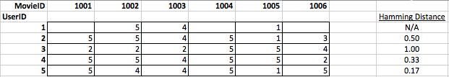
Import the data from text files into memory and created a User-Movie rating matrix
Select arbitrary UserID and use k-nearest neighbors algorithm to find k-most similar users via hamming distance
Hamming distance = (# of mismatched values / # of fields)

Slide 16
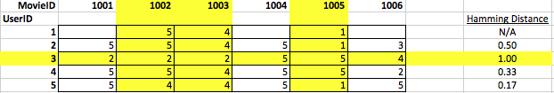
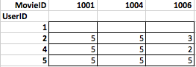
Select top 3 most similar users and remove movies that the selected user has already seen

Slide 17
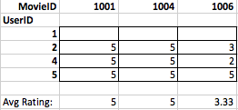
Find the average ratings of movies seen by the “nearest neighbors” that the user has not seen
Recommend the top rated films

Slide 18

Questions?

